Slide 1
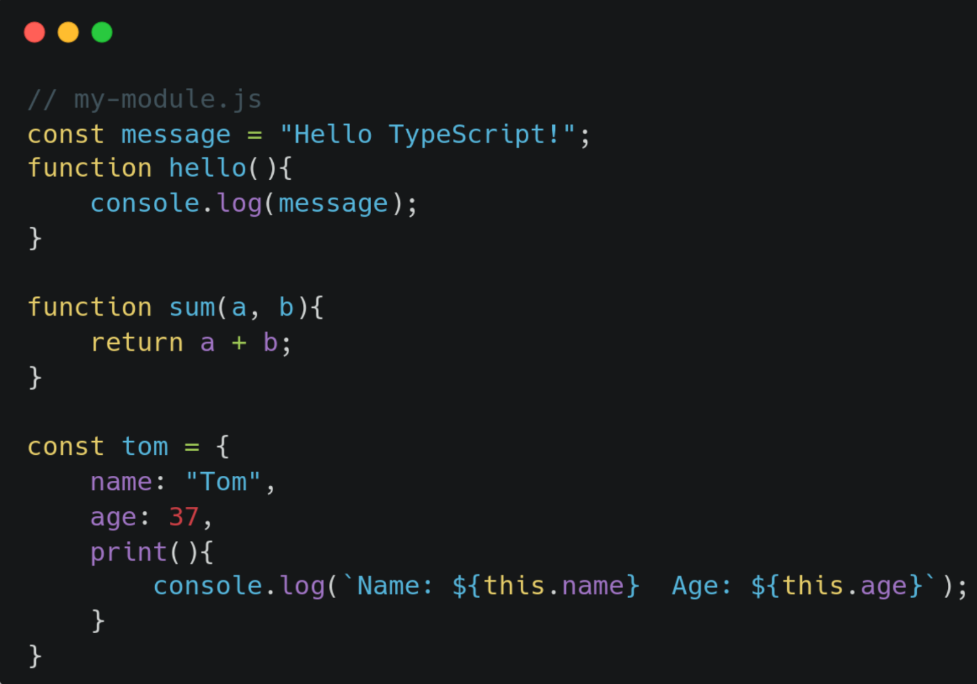
TypeScript vs Kotlin

Slide 2
Side by Side
 | TypeScript | Kotlin
Variables that CAN change | let | var
Variables that CANT change | const | val
Basic types | string, number, boolean | String, Int, Double, Boolean
Control flows | if-else/case | if-else/when
Loops | for/while | for/while
* It is important to note that in TypeScript, the types are lowercase, rather than starting with
a capital letter, like we are used to in Kotlin.
** It is also important to note, that the “when” statement from Kotlin is similar to the “case”
statement that we find in TypeScript.

Slide 3
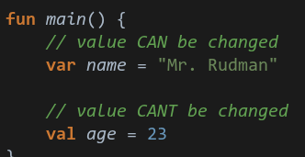
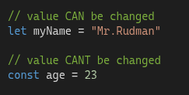
Variables
Kotlin
TypeScript

Slide 4
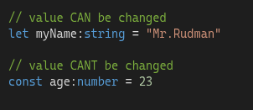
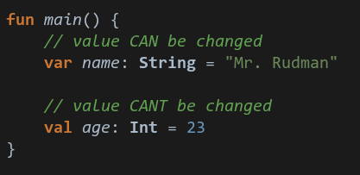
Basic Types
Kotlin
TypeScript
* Once again, remember that types in TypeScript are lowercase. They are added to a variable
by going :type, so in this case, age is the name of the variable, and :number is the type.

Slide 5
Quick activity :)
typescriptlang.org/play
Write code that does the following in TypeScript:
- Declares 2 variables, length and width
- Calculates the perimeter of a rectangle, and prints it out (all the sides added together)
- Calculates the area of a rectangle, and prints it out (length x width)
Be sure to:
- Use types for your variables
- The values will NOT change, so use the correct way to declare them
- Add basic comments explaining your code

